Slide 1
Upset Potential in the National Football League (NFL)
Mary J. Snyder
Advisor: Michael P. McGuire Ph.D.

Slide 2
Agenda
Introduction
Dataset
Experiment Design, Tools, & Approaches
Results
Conclusion

Slide 3
Introduction
Background
<why this topic>
Abstract
Determining factors that influence the potential for upsets in the NFL
Objectives
Fun applications
Fantasy Football
Spread or confidence point picks leagues
Teams preparation
Take steps to protect themselves
Focus their training to upset other teams

Slide 4
Dataset
Data attribute selection
Game information
Team, score, outcome, week
Statistics related
Injuries, average points for, average points against
Outside influence
Weather, time zone, time of games, number of days rest between games
Sources
Historical databases, NFL.com, weather databases

Slide 5
Experiment Design, Tools, & Approaches
Experiment Design, Tools, & Approaches
Results
Conclusion

Slide 6
Results
<insert results here>

Slide 7
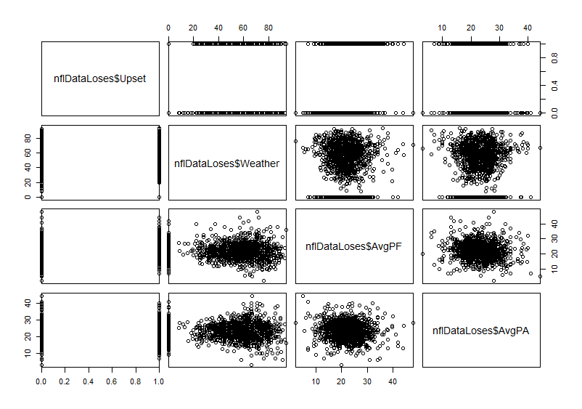
Results: Data Analysis (x of X)

Slide 8
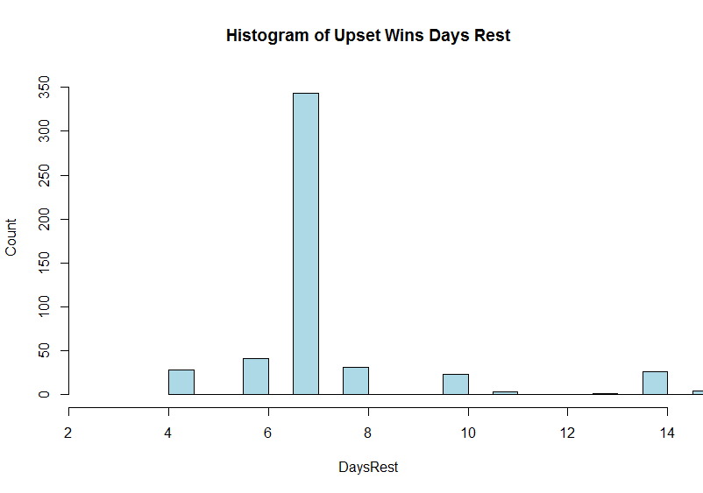
Results: Data Analysis (x of X)

Slide 9
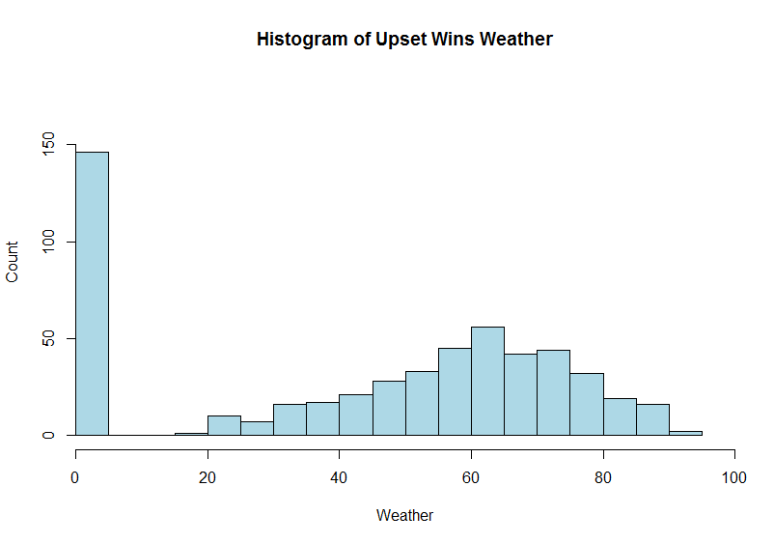
Results: Data Analysis (x of X)

Slide 10
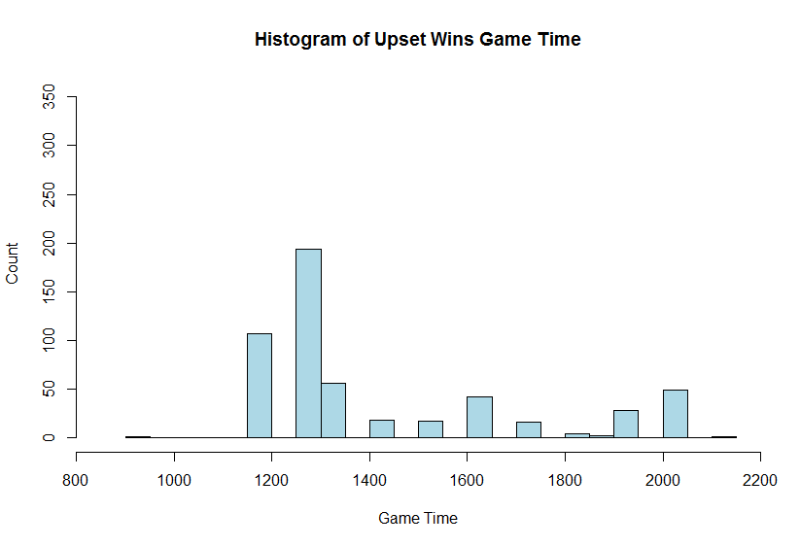
Results: Data Analysis (x of X)

Slide 11
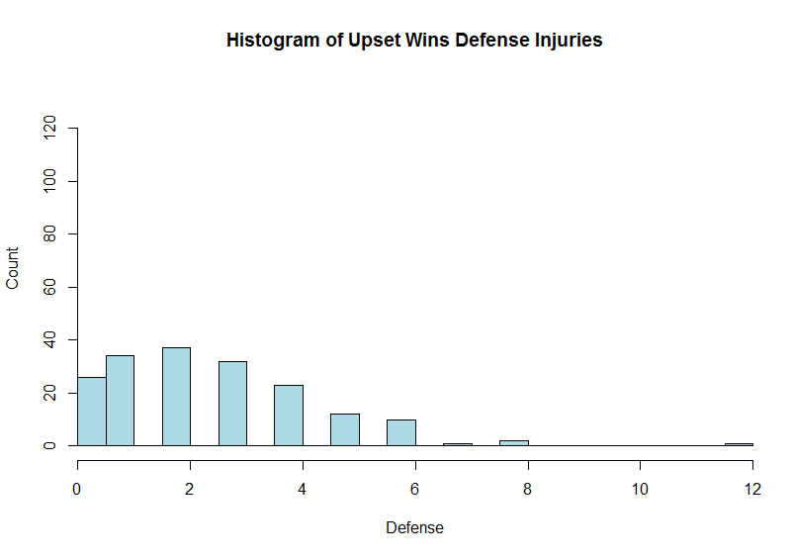
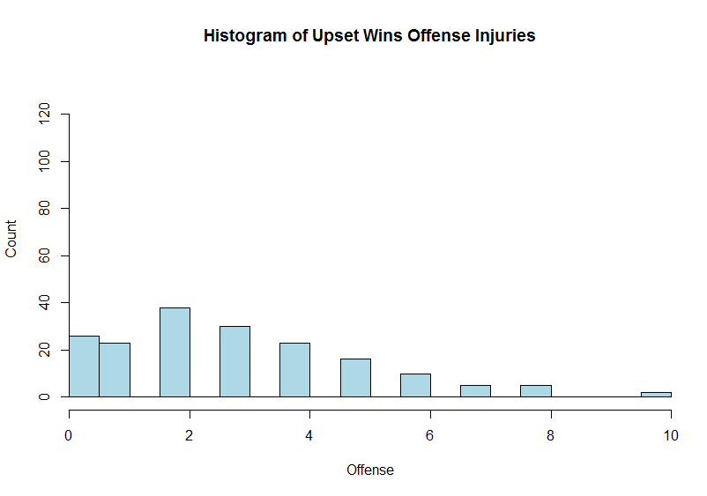
Results: Data Analysis (x of X)

Slide 12
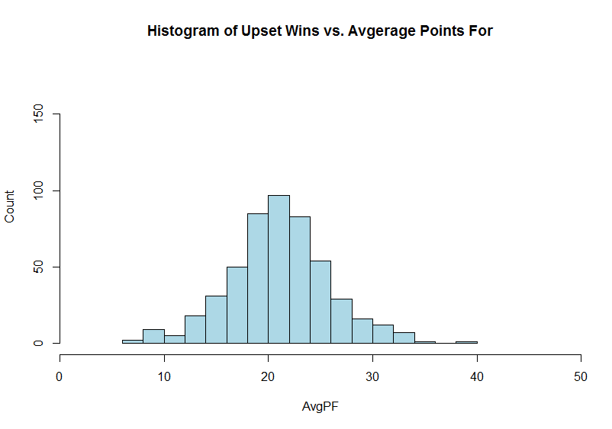
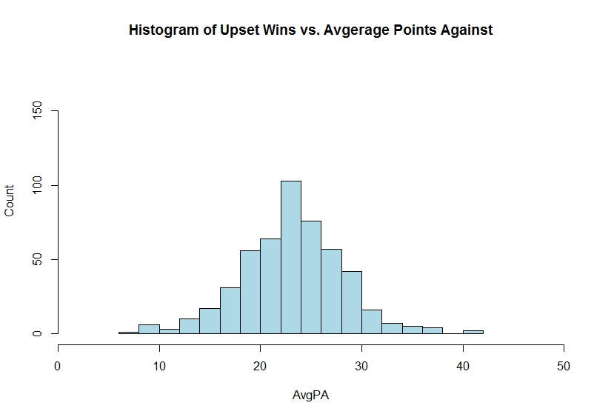
Results: Data Analysis (x of X)

Slide 13
Results: Data Analysis (x of X)

Slide 14
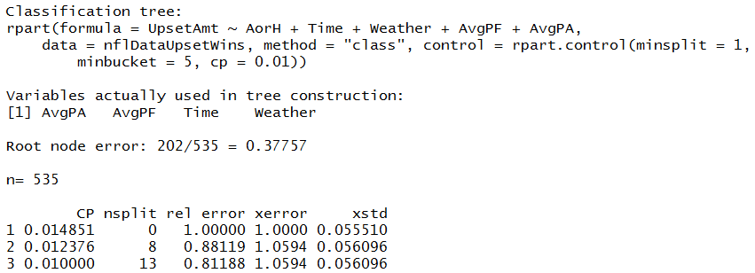
Results: Data Analysis (x of X)

Slide 15
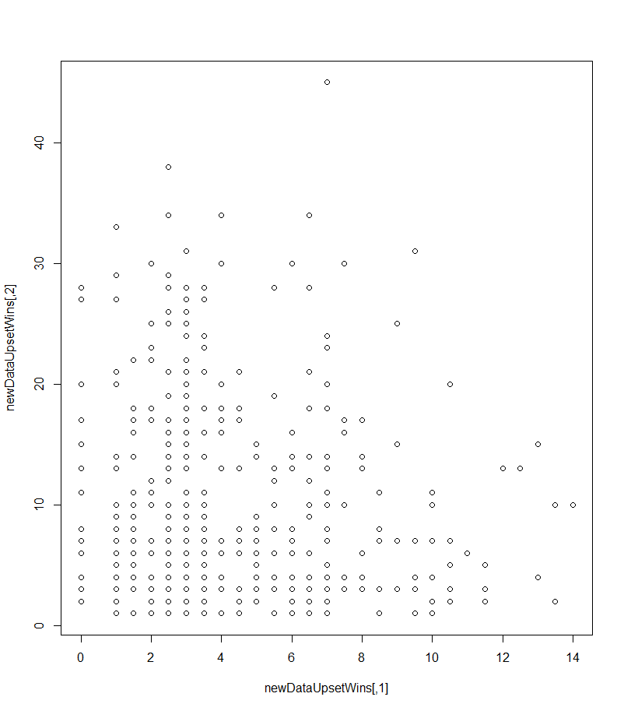
Results: Upset Amount – Clustering (x of X)

Slide 16
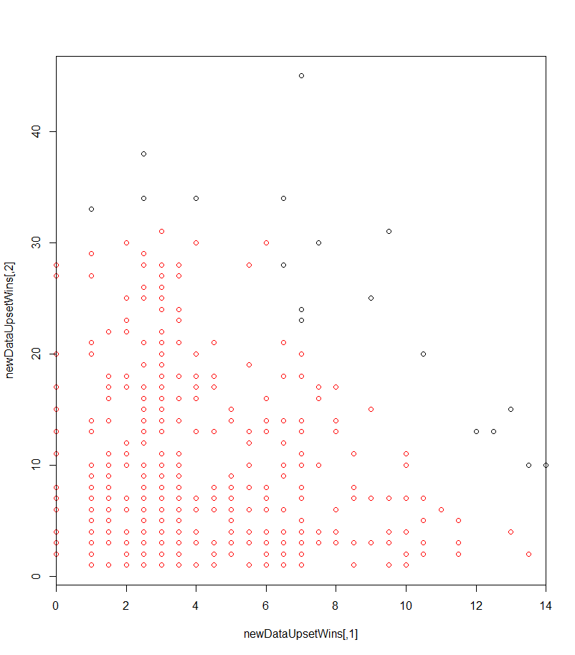
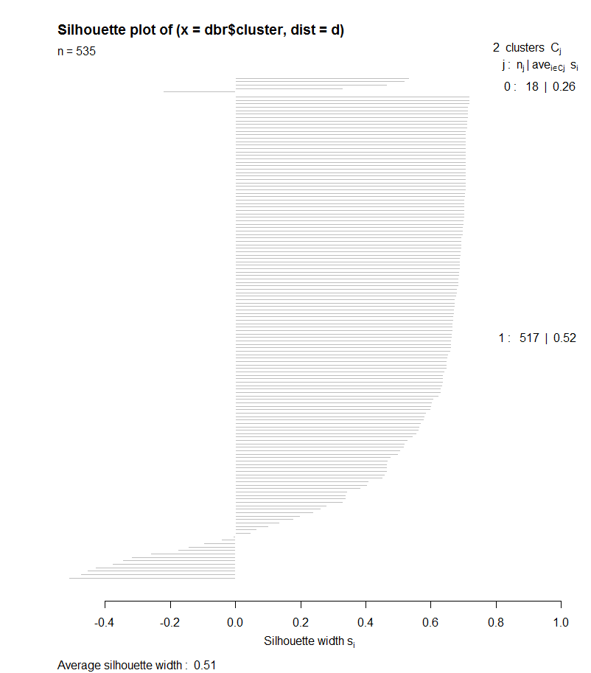
Results: Upset Amount – Clustering (x of X) <DBSCAN>

Slide 17
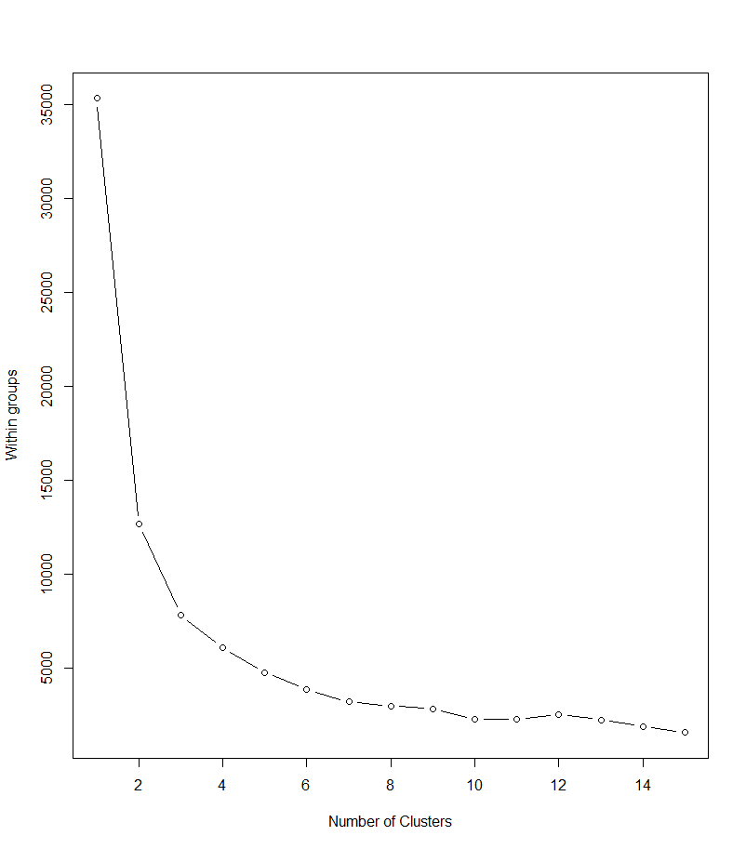
Results: Upset Amount – Clustering (x of X)

Slide 18
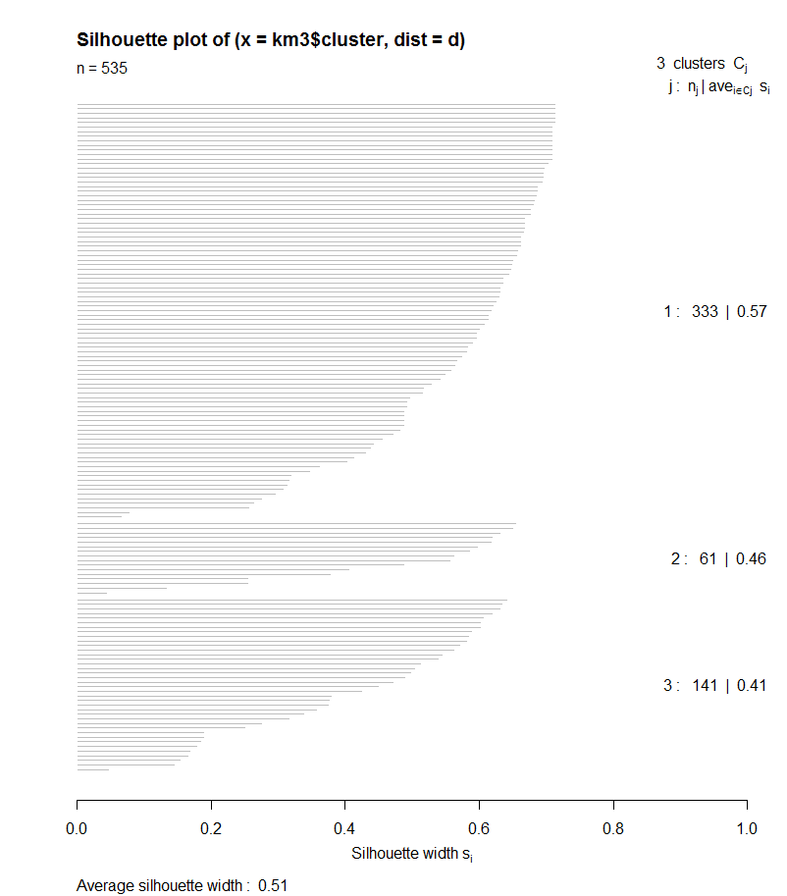
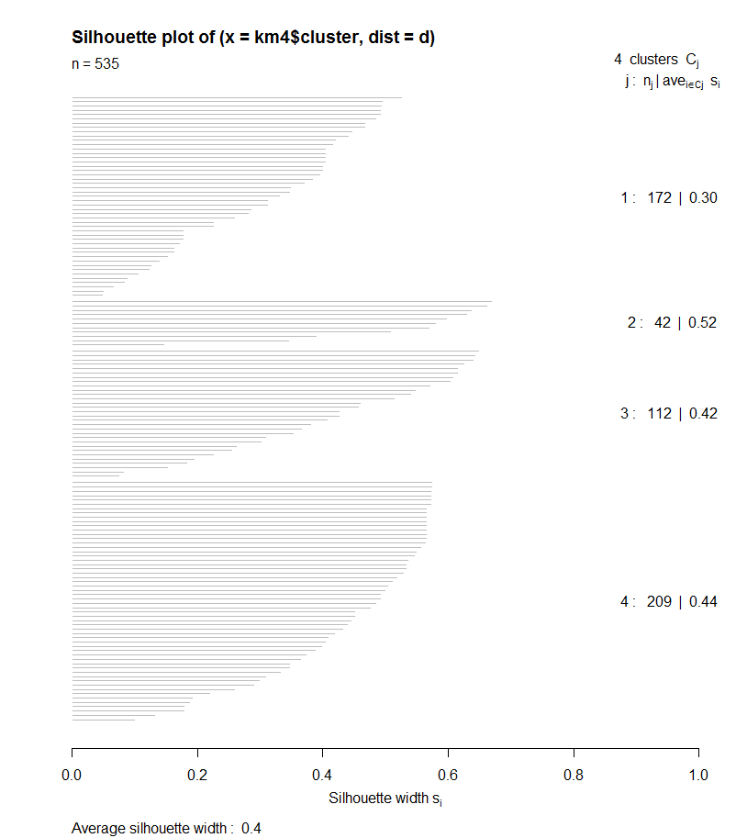
Results: Upset Amount – Clustering (x of X)
K-means cluster k=3
K-means cluster k=4

Slide 19
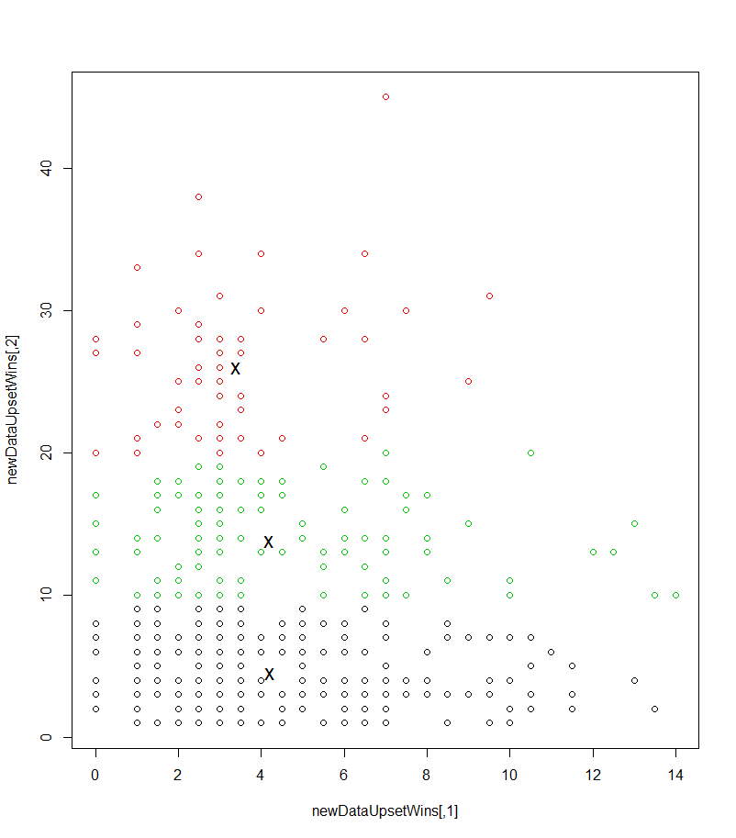
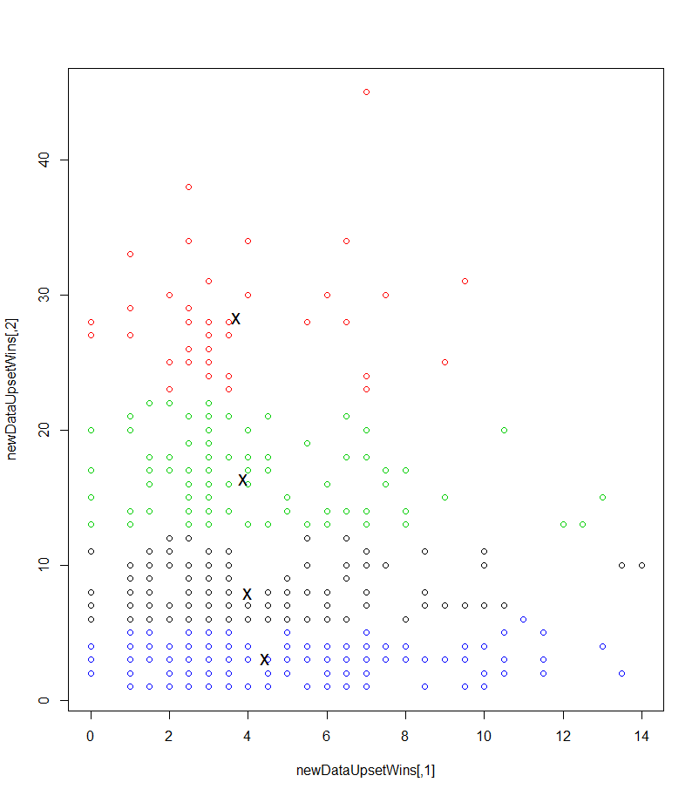
Results: Upset Amount – Clustering (x of X)
K-means cluster k=3
K-means cluster k=4

Slide 20
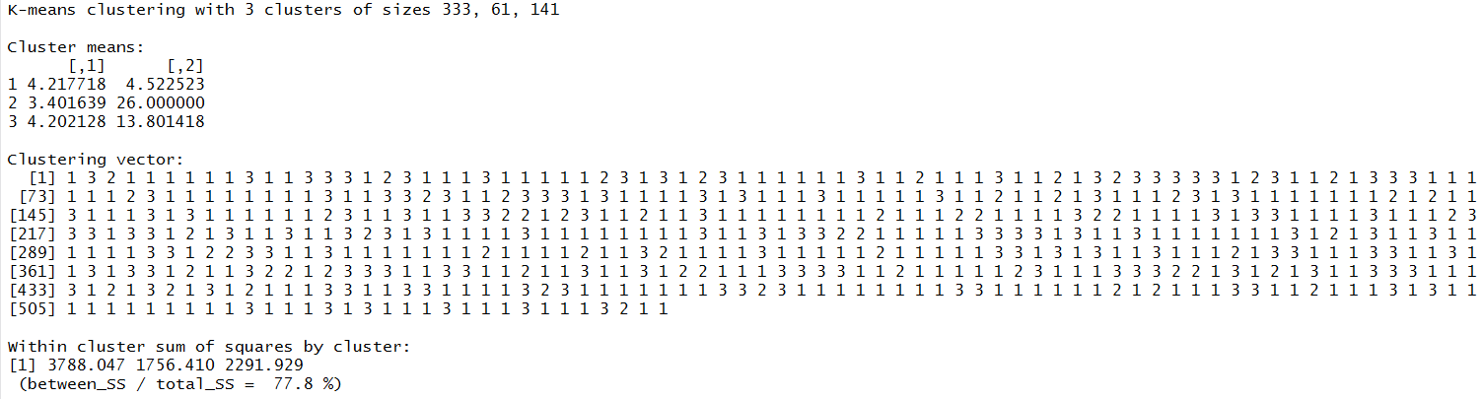
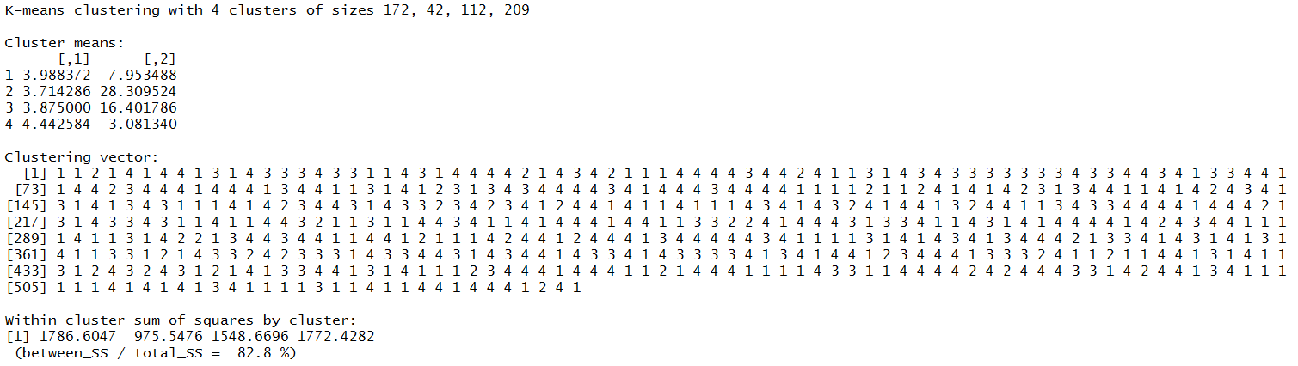
Results: Upset Amount – Clustering (x of X)
K-means cluster k=3
K-means cluster k=4

Slide 21
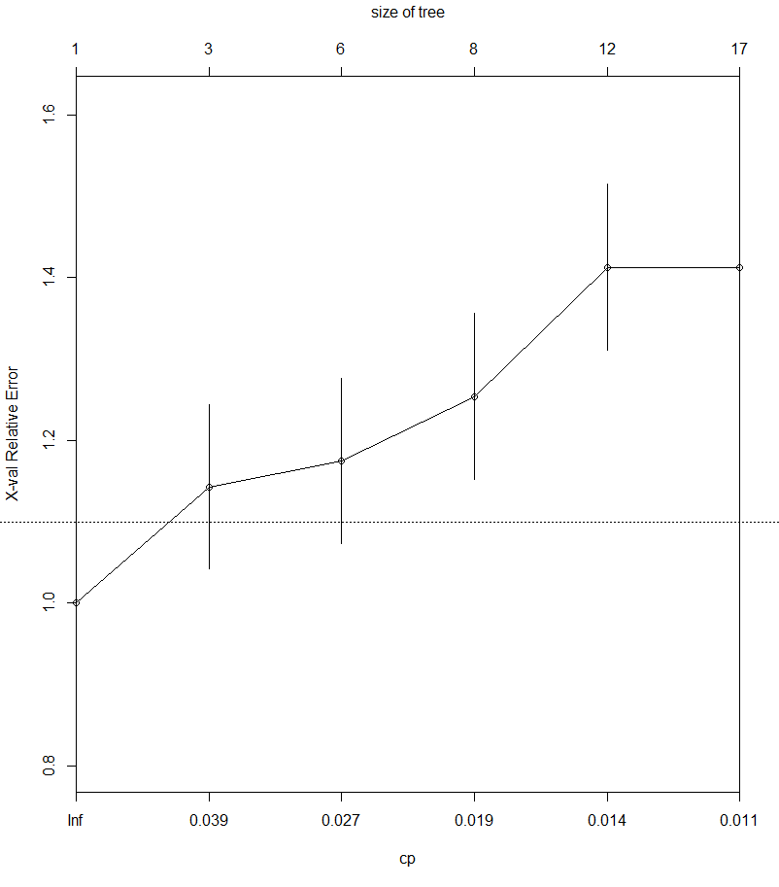
Results: Upset Amount – Classification (x of X)

Slide 22
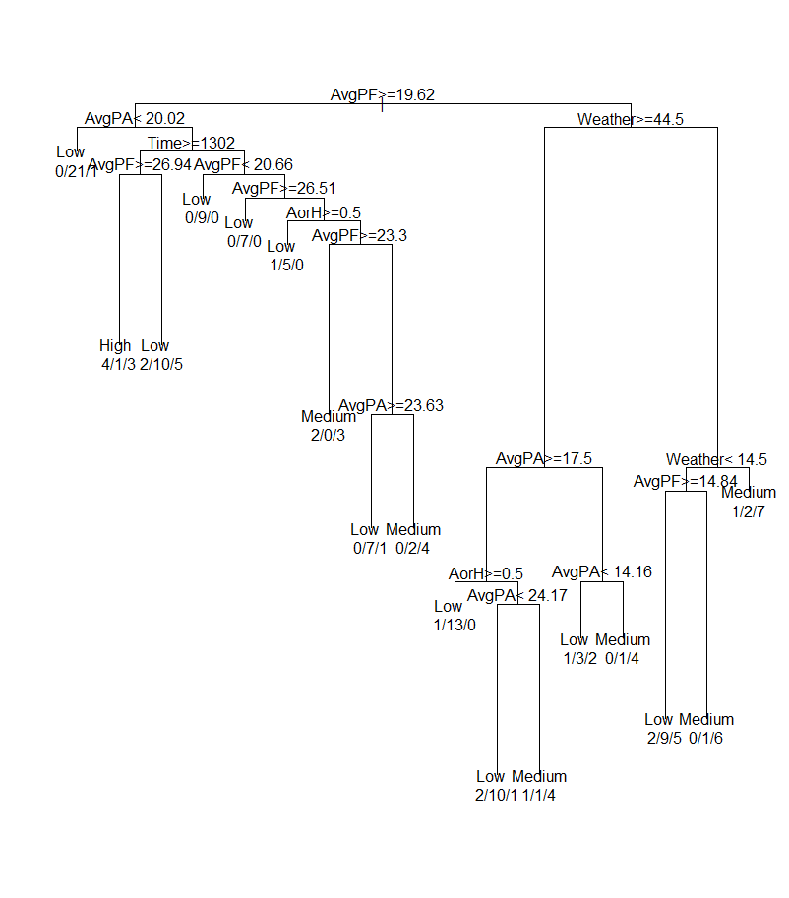
Results: Upset Amount – Classification (x of X)

Slide 23
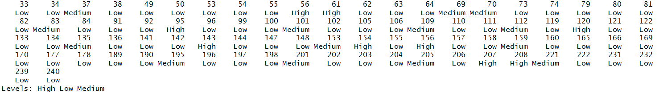

Results: Upset Amount – Classification (x of X)

Slide 24
Results: Upset Amount – Classification (x of X)

Slide 25
Conclusion
<insert conclusions here>

Slide 26
Question
<insert here>

